Slide 1
Commas – to separate items in a series
Use commas to make a list
On Thanksgiving, I will eat turkey, mashed potatoes, and green beans.
If the list items contain commas, use a semicolon instead.
I need to buy soap, which will go in the bathroom; tissues, which will go in the living room; and paper towels, which will go in the kitchen.

Slide 2
Commas – used conventionally
Use commas to separate names and titles
Dr. Susan Smith, M.D.
Martin Luther King, Jr.
Dr. J.B. Embry, D.D.S.
Use commas to separate city and state names
I live in Lexington, Kentucky.
Use commas when writing dates.
Today is Monday, October 17, 2016.
Use commas to start and end a letter
Dear Mr. Jones,
Sincerely,

Slide 3
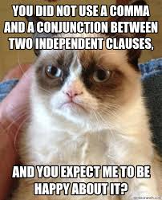
Use commas to connect independent clauses
What is an independent clause?
An independent clause is a full sentence that can stand on its own
To connect two sentences, use a comma and a coordinating conjunction
We went to the mall. We also went to the grocery.
Correct: We went to the mall, and we also went to the grocery.
Incorrect: We went to the mall, we went to the grocery.
This is called a comma splice, and it is evil.

Slide 4
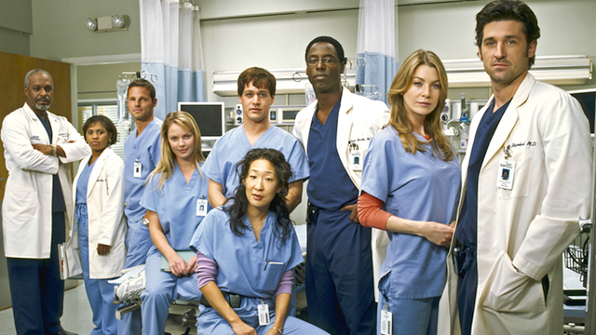
Commas with introductory elements
Put a comma after any introductory word or phrase
Tonight, I will watch Grey’s Anatomy.
While I watch Grey’s Anatomy, I will eat ice cream.
Why did McDreamy have to leave? Well, I’m not sure the answer to that question.

Slide 5
Commas with non-essential phrases
Use commas to separate unnecessary information from the rest of the sentence
I’m having dinner with my brother, who loves the Chicago Cubs, and my sister, who is six feet tall.
Does the phrase have anything to do with the main point of the sentence? If not, then separate it with commas.
Everybody who is interested in trying out for the wrestling team should be very athletic.
Does the phrase provide important clarity about the subject of the sentence? If so, do not separate it with commas.
All the students, who love to eat ice cream, wanted school to end early.

Slide 6
Commas with interrupters
Use commas to set off direct addresses
As I was saying, Jim, I don’t want you to shout.
Ryan, please put your paper in your backpack.
Use commas to separate interjections
Today I might, um, go to the store.
Did you know the book, I mean, the book by J.K. Rowling, is awesome?

