Slide 1
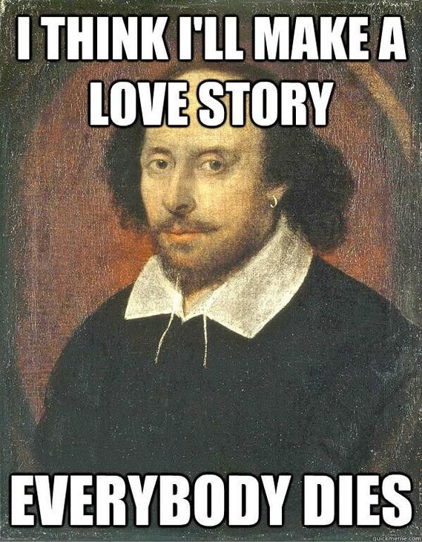
William Shakespeare
A brief biography
Shakespeare Mini Biography Video

Slide 2
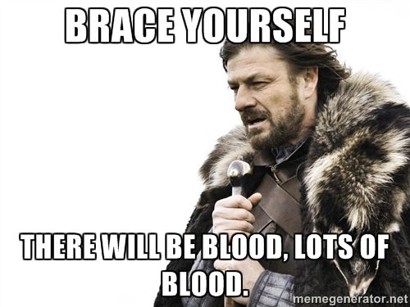
Macbeth
Macbeth is one of Shakespeare’s tragedies.
A tragedy to Shakespeare involves a character of high rank who falls due to a personal flaw.

Slide 3
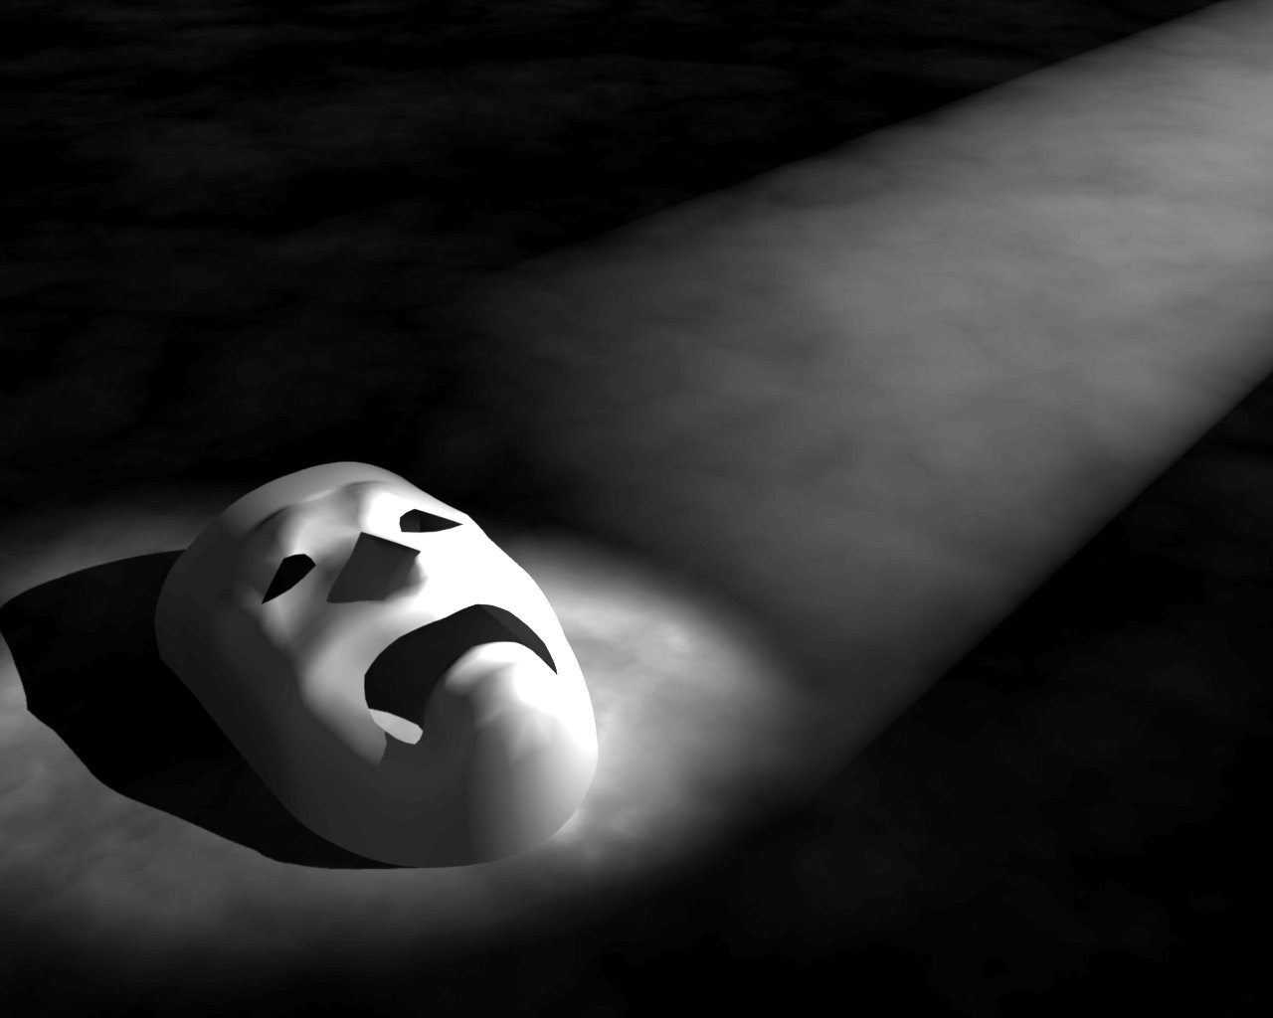
Characteristics of
a shakespearean tragedy
A tragedy is a drama in which a series of actions leads to the downfall of the main character, called the tragic hero.
The plot builds to a catastrophe, or a disastrous final outcome, that usually involves the death of the hero and many others.
To create suspense before this inevitable outcome and to help the audience understand the characters, Shakespeare used certain dramatic conventions, including dramatic irony, the soliloquy, and the aside.

Slide 4
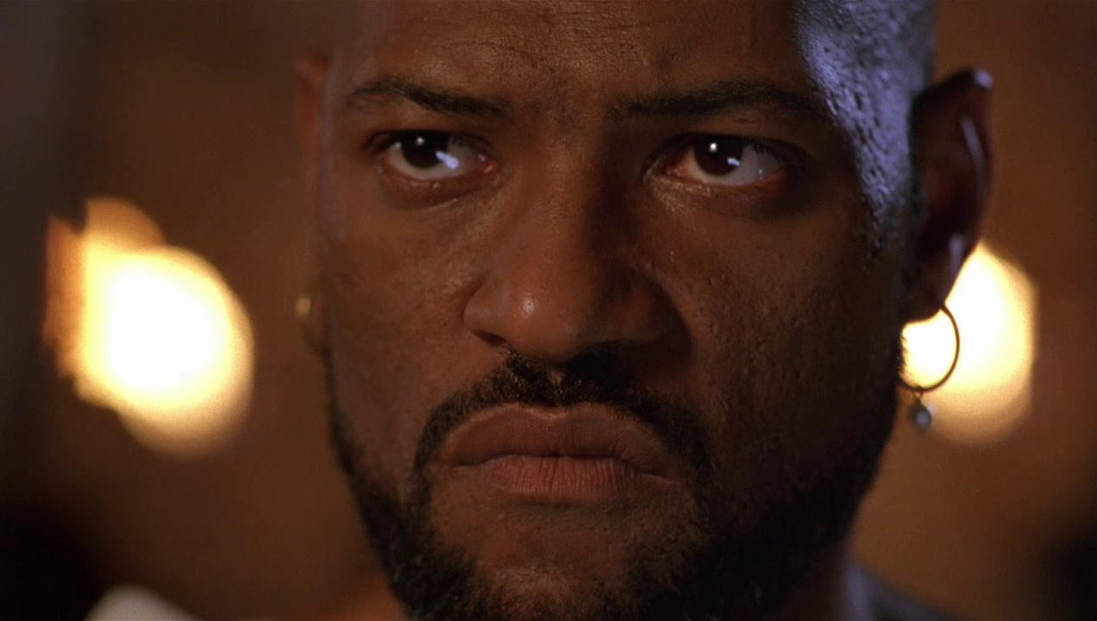
Main character
Tragic hero
Of high social rank (a king, prince, or general)
Has a tragic flaw, an error in judgement or a character defect, that ultimately leads to his or her downfall.
Suffers complete ruin or death
Faces his or her downfall
with courage and dignity

Slide 5
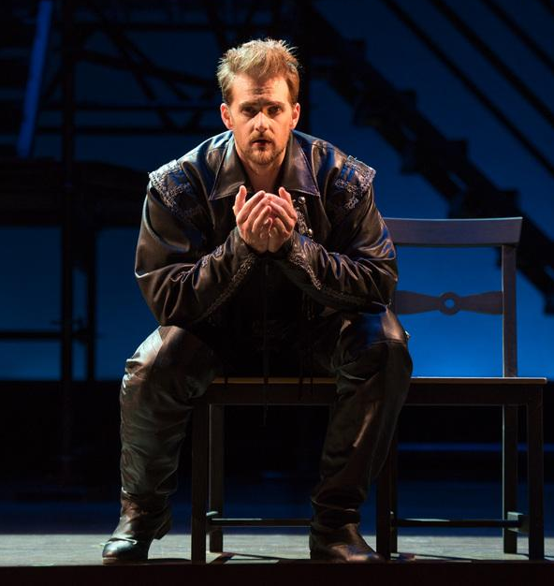
Dramatic conventions
Dramatic Irony
Results when the audience knows more
than the character(s)
Helps build suspense
Soliloquy
A speech given by a character alone on a stage
Used to reveal his/her private thoughts and feelings
May help the audience understand a character’s motivation

Slide 6
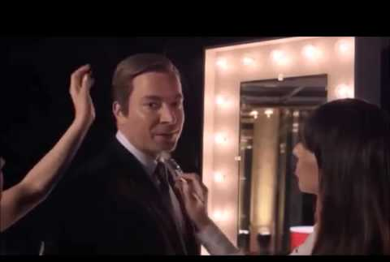
Dramatic
conventions
Aside
A character’s remark, either to the audience or to another character, that no one else on stage is supposed to hear
Lets the audience in on the character’s thoughts or secrets
Aka: “breaking the fourth wall”

Slide 7
style
Meter: The repetition of stressed and unstressed syllables in verse
Blank Verse: Unrhymed lines of iambic pentameter
Iambic Pentameter: has five unstressed syllables, each followed by a stressed syllable
˘ ʹ ˘ ʹ ˘ ʹ ˘ ʹ ˘ ʹ
So foul and fair a day I have not seen.
Example: So foul and fair a day I have not seen. (Act I, Scene 3)

Slide 8
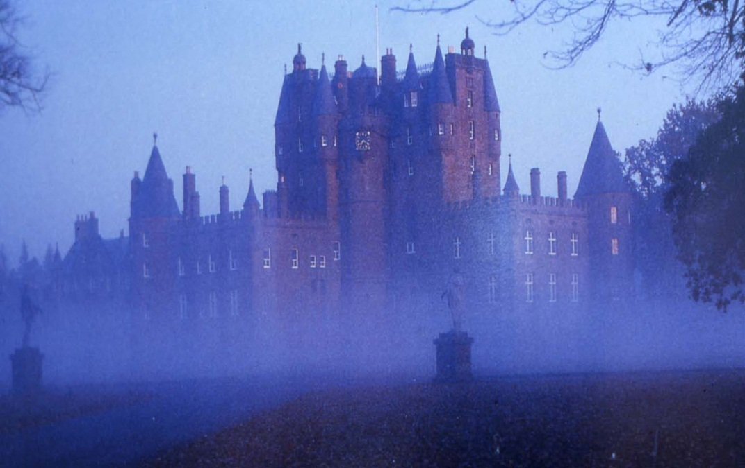
Setting
Scotland
Inverness Castle, Macbeth’s home, and other clammy places
Time: the 11th century, Thursday, around tea time
Atmosphere: dark, gloomy, foreboding, generally nasty

Slide 9
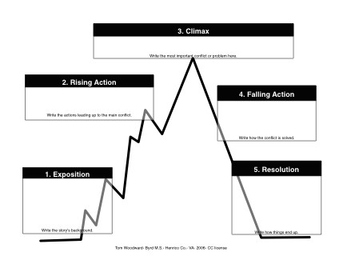
Plot
Shakespeare follows a formula for most of his plays
Act I: exposition
Act II: rising action
Act III: climax
Act IV: falling action
Act V: resolution
(denouement)

Slide 10
Macbeth
A capable general at the service of King Duncan
His title is Thane (Earl) of Glamis
Rewarded with new title:
Thane of Cawdor
He has a tragic flaw: ambition

Slide 11
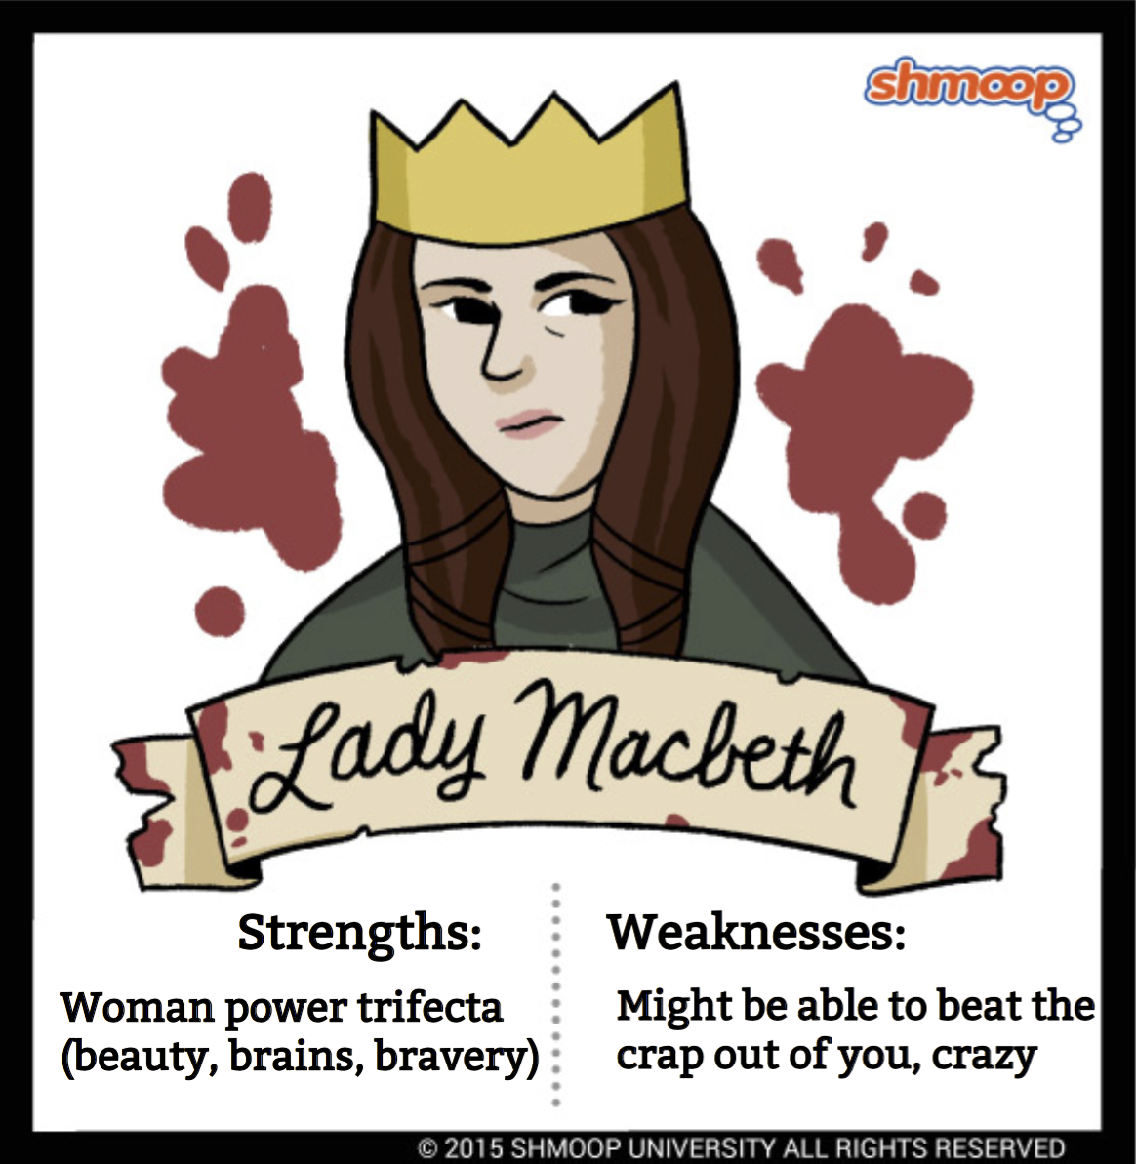
Lady Macbeth
Macbeth’s wife
She is even more ambitious than
her husband
She knows how to manipulate
Macbeth

Slide 12
King Duncan
The well-respected king of Scotland
He is older than Macbeth
Macbeth’s kinsman (“cousin”)
Macbeth is very loyal
to him – at the beginning
Two sons: Malcolm and Donalbain

Slide 13
Malcolm
King Duncan’s eldest son
Heir to the throne of Scotland
Saves the kingdom

Slide 14
Banquo
Macbeth’s great friend
Also a general in Duncan’s army
Son: Fleance
Prophecy: he will give rise to
many kings of Scotland
James I of England was also
James VI of Scotland,
said to be a descendant of
Banquo
A character foil to Macbeth

Slide 15
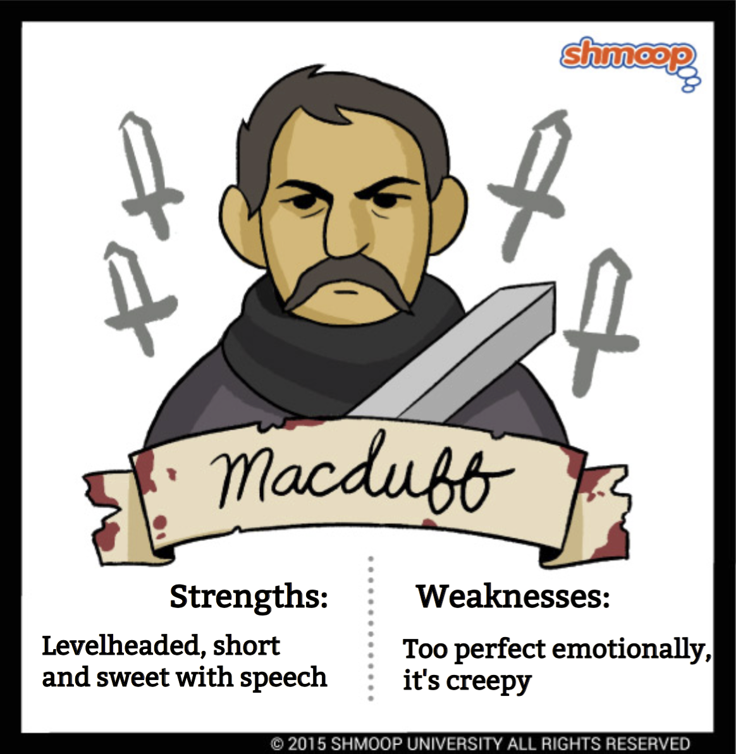
Macduff
Another thane (of Fife) and general
Becomes important in the final act
Has a wife and son

Slide 16
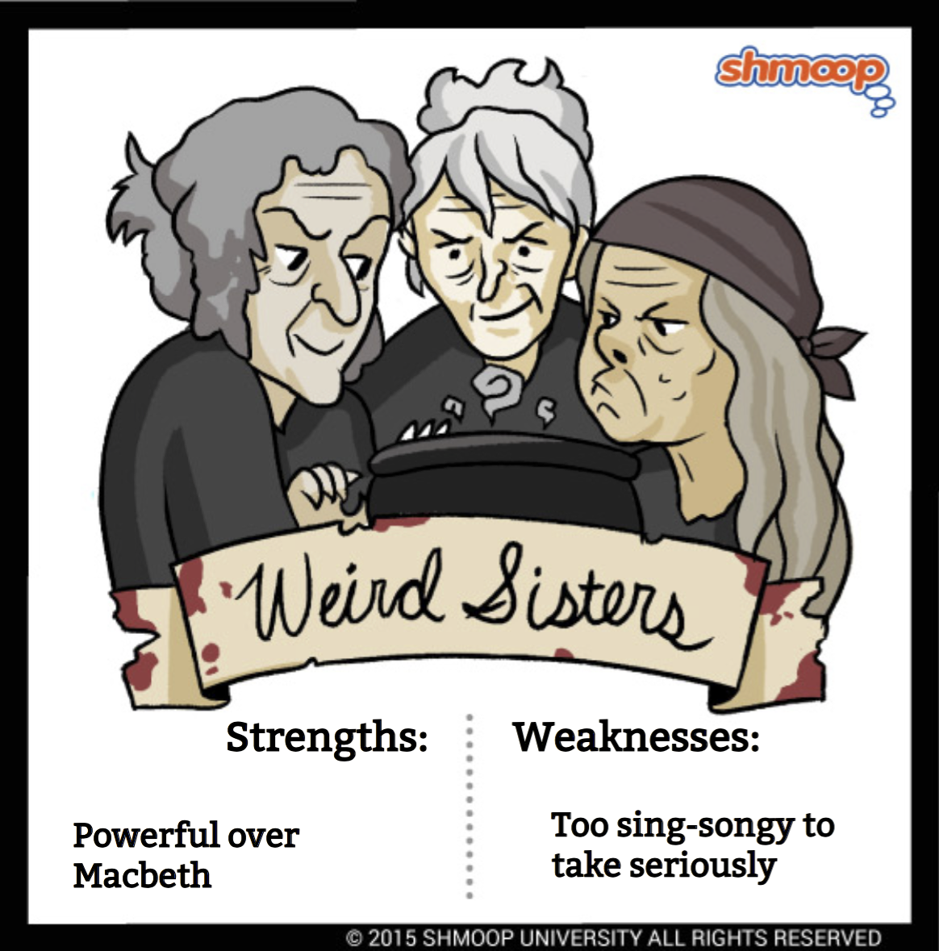
The
Three Witches
People believed that witches caused misfortune
had “familiars” or animal spirits to assist them
represented a challenge to the established order
James I had written a book on how to detect and try witches
Many witches were burned during his reign

Slide 17
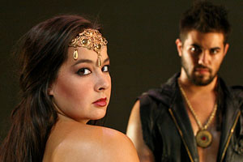
Themes
The universal tendency to abuse power
The endless cycle of violence and betrayal
Questions the balance of morality, politics, and power

