Slide 1
MLA Format and Citations

Slide 2
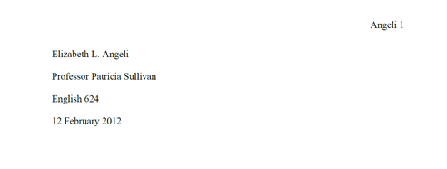
Basics
Papers should be typed in Times New Roman font, size 12
Papers should be double spaced.
You do not need a cover page. Include a heading on page 1 with your name, the name of the instructor, the name of the class, and the date the paper is due.
Include a page number on the top right corner of each page, including your last name.
Margins should be 1 inch wide

Slide 3
Basics
In academic writing, refrain from using personal pronouns such as “I”, “my”, “you”, etc.
The first time you refer to the author, use first and last name. Each subsequent time, use last name only. For example, when referring to the author of Night, say “Elie Wiesel” the first time and “Wiesel” each subsequent time. Do NOT simply say, “Elie”.
Use academic present tense in your writing. For instance, “Harper Lee uses the theme of innocence…”
Incorrect: “Harper Lee used the theme of innocence…”

Slide 4
Textual Support
In every essay you write, you will be required to use quotes from one or more texts.
When you quote from a text, you are required to include an in-text citation, which identifies the source that the quote is from.
At the end of the essay, you are required to make a list of all the sources you cited in your project. This list is called your Works Cited page.

Slide 5
Works Cited Page
Using MLA format, create citations for each source that you quoted in your project. Citations include the author of the source, the title of the source, date of publication, medium of publication, and date of access. Citations should include page number(s) of the source, if available.
The format for a book citation is as follows:
Lastname, Firstname. Title of Book. City of Publication: Publisher, Year of Publication. Medium of Publication.
Example of a citation for a book:
Gleick, James. Chaos: Making a New Science. New York: Penguin, 1987. Print.

Slide 6
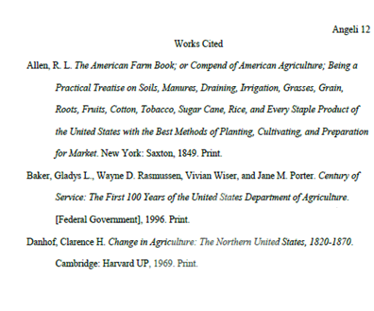
Works Cited Page, cont.
How to format the Works Cited Page :
Double spacing
Hanging indent
Title centered at top of page
Sources listed in alphabetical order

Slide 7
Works Cited Page, cont.
All quotes cited within your paper should be documented with a citation on your Works Cited page
All sources on your Works Cited page should be cited somewhere in your paper.

Slide 8
In-text citation format
In-text citations should include author’s name and page number.
Citation should be placed at the end of the sentence, after the quote, but before the punctuation. For example:
“In many cases a true war story cannot be believed” (O’Brien 68).
If no page number is available, simply include the author’s name. For example:
“To children ardent for some desperate glory” (Owen).

Slide 9
In-text citation format, cont.
You may also include the author’s name in the body of your writing, in which case you do not need to include it in the parenthetical citation. For example:
In his book The Things They Carried, Tim O’Brien writes, “In many cases a true war story cannot be believed” (68).
If a work has no known author, put the title of the work in quotation marks. For example:
“By hell-forged hands, His misery leaped/ The seas, was told and sung in all/ Men's ears” (“Beowulf”, 28).

Slide 10
In-text citation format: Drama
When citing quotes from a play, use the act, scene, and line numbers, with a period in between each. If you have mentioned the author’s name somewhere earlier in the paper, you do not need to include it in your parenthetical citation. For example, a quote from Romeo and Juliet from Act 1, Scene 2, lines 1-3 should be cited as follows:
“CAPULET
But Montague is bound as well as I,
In penalty alike, and 'tis not hard, I think,
For men so old as we to keep the peace”
(I.ii.1-3).
On your Works Cited page, cite the play the same way you would cite a book.

Slide 11
If you need to know how to create a citation for a source other than a book or a play, or if you forget anything you’ve learned today, go to the Purdue Online Writing Lab for help with all things MLA! https://owl.english.purdue.edu/owl/resource/747/01/

Slide 12
What is Plagiarism?
“The act of appropriating the literary composition of another, or parts, or passages of his/her writings of ideas, or the language of the same, passing them off as the product of one’s own mind” (Black’s Law Dictionary, 5th Edition).

Slide 13
What happens if I plagiarize?
At Tates Creek, all students are held to the Academic Honor Code.
In college, you could:
Fail a course
Be placed on academic probation
Be expelled from school
Have your degree revoked

