Slide 1
Poetry Terminology

Slide 2
Poetry Terminology
Stanza: Groups of lines in a poem -- the “paragraphs” of poetry

Slide 3
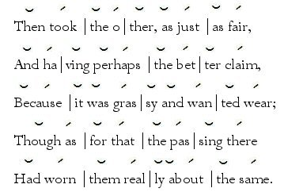
Meter: The repeated pattern of stressed and unstressed syllables in each line
Follows a rhythm
Can be even or uneven

Slide 4
Rhythm: The alternation of stressed and unstressed sounds that makes the voice rise and fall.
https://www.youtube.com/watch?v=6U-CRhnDyK8
(Because I could not Stop for Death reading)

Slide 5
Metrical foot: A group of syllables that help create meter
Occur in patterns of stressed and unstressed syllables

Slide 6
Iamb: A metrical foot consisting of an unstressed syllable followed by a stressed syllable (light/heavy)
Most common meter in poetry
Example: underline the stressed syllables
Because I could not stop for death

Slide 7
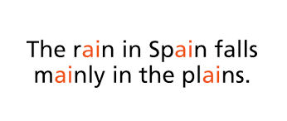
Assonance: The repetition of vowel sounds close together

Slide 8
Consonance: The repetition of consonant sounds close together

Slide 9
Parallel structure: involves putting together elements of similar structure to achieve balanced writing.
To make your writing parallel, use the same grammatical form for all items in a list.

Slide 10
Parallel Structure Continued
Poor: Betty has intelligence, honesty, and she is funny. Improved: Betty has intelligence, honesty, and humour.
Poor: Good writing requires you to plan outlines, write several drafts, and revision. Improved: Good writing requires you to plan outlines, write several drafts, and revise your work.

